Slide 1
RISC-V Data Transfer

Slide 2
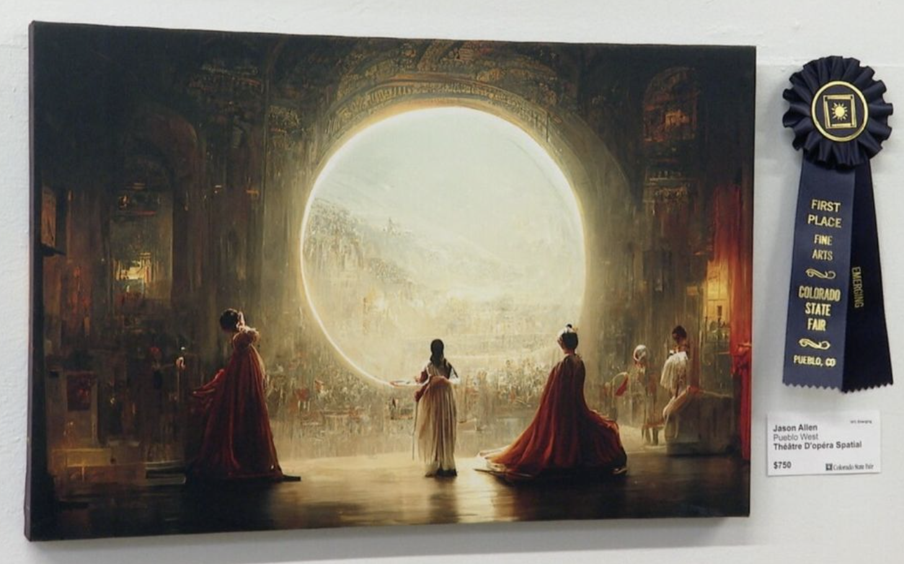
IS AI-GENERATED ART FAIR?
This year, the Colorado State Fair’s annual art competition gave out prizes in all the usual categories: painting, quilting, sculpture. But one entrant, Jason M. Allen of Pueblo West, Colo., didn’t make his entry with a brush or a lump of clay. He created it with Midjourney, an artificial intelligence program that turns lines of text into hyper-realistic graphics. Mr. Allen’s work, “Théâtre D’opéra Spatial,” took home the blue ribbon in the fair’s contest for emerging digital artists — making it one of the first A.I.-generated pieces to win such a prize, and setting off a fierce backlash from artists who accused him of, essentially, cheating. Reached by phone on Wednesday, Mr. Allen defended his work. He said that he had made clear that his work — which was submitted under the name “Jason M. Allen via Midjourney” — was created using A.I., and that he hadn’t deceived anyone about its origins.
“I’m not going to apologize for it,” he said. “I won, and I didn’t break any rules.”
www.nytimes.com/2022/09/02/technology/ai-artificial-intelligence-artists.html

Slide 3

Art, AI Collide in Landmark Legal Dispute
Human artists and artificial intelligence (AI) companies are disputing generative AI-intellectual property in a landmark legal case.
Visual media company Getty Images filed a copyright claim against free image-generating Stable Diffusion tool developer Stability AI in the U.K. High Court.
The tool was trained on 2.3 billion images harvested from the Web by a third-party website; Getty alleges Stability AI illegally copied and processed copyrighted images for its commercial benefit.
Sandra Wachter at the U.K.'s Oxford Internet Institute said the case will decide whether companies can use such data for their own purposes.
Said Estelle Derclaye at the U.K.'s University of Nottingham, "Ultimately, [AI companies] are copying the entire work in order to do something else with it — the work may not be recognizable in the output, but it's still required in its entirety."
cacm.acm.org/news/269122-art-ai-collide-in-landmark-legal-dispute

Slide 4
Storing Data in Memory

Slide 5
RV32 So Far…
Addition/subtraction
add rd, rs1, rs2
R[rd] = R[rs1] + R[rs2]
sub rd, rs1, rs2
R[rd] = R[rs1] - R[rs2]
Add immediate
addi rd, rs1, imm
R[rd] = R[rs1] + imm
Notes:
Each kernel has a register footprint
And note that register use can be optimized better than I did before

Slide 6
Data Transfer: Load from and Store to memory
P
r
o
c
e
s
sor
Memo
r
y
Enabl
e
?
I
C
n
put
on
t
r
ol
R
ead
/
W
r
i
t
e
P
r
o
g
r
am
A
dd
r
e
s
s
D
a
t
ap
at
h
Much larger place to hold values, but slower than registers!
P
r
o
g
r
am
C
oun
t
er (PC)
B
y
t
e
s
R
egi
s
t
e
r
s
W
r
i
t
e
D
a
t
a
D
a
t
=
S
a
t
o
r
e
t
o
Memo
r
y
R
ead
D
a
t
a
A
r
i
t
hm
e
t
i
c
-Logic
Ou
t
= Load from
put
U
nit
(
A
L
U)
Memo
r
y
Very fast, but limited space to hold values!
Notes:
Memory is a large, one-dimensional array with the address acting as the index to that array, starting at 0. To access a word in memory, processor must supply an address. The address is specified as an offset to a base pointer.

Slide 7
Memory Addresses are in Bytes
Data typically smaller than 32 bits, but rarely smaller than 8 bits (e.g., char type)–works fine if everything is a multiple of 8 bits
8 bit chunk is called a byte (1 word = 4 bytes)
Memory addresses are
really in bytes, not words
Word addresses are 4 bytes apart
Word address is same as address of rightmost byte – least-significant byte (i.e. Little-endian convention)
3
2
1
0
31
0
Notes:
Words in memory are 32-bits wide, perfectly matching our registers. So when we retrieve a word from memory, it fits perfectly into a register. And 1 word is 4 bytes. But keep in mind that we often work with narrower data than 32-b, very commonly with bytes (8 bits). So how are the bytes packed into words?

Slide 8
Memory Addresses are in Bytes
Data typically smaller than 32 bits, but rarely smaller than 8 bits (e.g., char type)–works fine if everything is a multiple of 8 bits
8 bit chunk is called a byte (1 word = 4 bytes)
Memory addresses are
really in bytes, not words
Word addresses are 4 bytes apart
Word address is same as address of rightmost byte – least-significant byte (i.e. Little-endian convention)
Least-significant byte in a word
15 | 14 | 13 | 12
11 | 10 | 9 | 8
7 | 6 | 5 | 4
3 | 2 | 1 | 0
31 24
23 16
15 8
7 0
Least-significant byte gets the smallest address
Notes:
That is shown here. The least significant byte goes to the lowest address.

Slide 9
Big Endian vs. Little Endian
en.wikipedia.org/wiki/endianness
The adjective endian has its origin in the writings of 18th century writer Jonathan Swift. In the 1726 novel Gulliver's Travels, he portrays the conflict between sects of Lilliputians divided into those breaking the shell of a boiled egg from the big end or from the little end. He called them the "Big-Endians" and the "Little-Endians".
The order in which BYTES are stored in memory
Bits always stored as usual within a byte (E.g., 0xC2=0b 1100 0010)
Consider the number 1025 as we typically write it: BYTE3 BYTE2 BYTE1 BYTE0 . 00000000 00000000 00000100 00000001
Big Endian
ADDR3 ADDR2 ADDR1 ADDR0 BYTE0 BYTE1 BYTE2 BYTE3 00000001 00000100 00000000 00000000
Examples
Names in China or Hungary (e.g., Garcia Dan)
Java Packages: (e.g., org.mypackage.HelloWorld)
Dates in ISO 8601 YYYY-MM-DD (e.g., 2020-09-07)
Eating Pizza crust first
Little Endian
ADDR3 ADDR2 ADDR1 ADDR0 BYTE3 BYTE2 BYTE1 BYTE0 00000000 00000000 00000100 00000001
Examples
Names in the US (e.g., Dan Garcia)
Internet names (e.g., cs.berkeley.edu)
Dates written in Europe DD/MM/YYYY (e.g., 07/09/2020)
Eating Pizza skinny part first
Notes:
Consider number

Slide 10
Data Transfer Instructions

Slide 11
Great Idea #3: Principle of Locality / Memory Hierarchy
Processor chip
Extremely fast
Extremely expensive Tiny capacity
C
o
r
e
Registers
Fast
Priced reasonably Medium capacity
DRAM chip
e.g. DDR3/4/5 HBM/HBM2/3
P
hy
si
c
al Memo
r
y
R
andom
-
A
cc
e
s
s Memo
r
y (RAM)

Slide 12
Speed of Registers vs. Memory
Given that
Registers: 32 words (128 Bytes)
Memory (DRAM): Billions of bytes (2 GB to 96 GB on laptop)
and physics dictates…
Smaller is faster
How much faster are registers than DRAM??
About 50-500 times faster! (in terms of latency of one access - tens of ns)
But subsequent words come every few ns

Slide 13
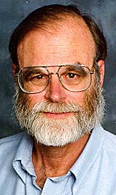
Jim Gray’s Storage Latency Analogy: How Far Away is the Data?
Jim Gray Turing Award
B.S. Cal 1966
Ph.D. Cal 1969
T
h
e
T
h
T
e
h
T
e
h
T
h
T
e
he
he
The
im
The
ima
…
T
ima
h
T
g
…
The
he
ima
im
T
ge
…
The
h
Sacramento
1.5 hr
ima
The
e
T
g
…
ima
h
The
e
ge
…
imag
T
T
e
p
…
The
T
h
h
image
T
h
e
part
…
The
he
100
Memory
image
The
im
part
…
The
The
ima
image
image
ge
…
part
…
The
T
T
part
…
image
T
T
h
h
part
…
The
T
h
h
image
h
part wit
…
The
T
e
image
h
T
T
part
…
The image
h
he
T
part with
he
The
relationsh
…
The
ima
…
The
image
i
part wit
…
The
…
T
The
im
…
he
imag
…
The
…
The
ima
image
…
The
image
…
The
i
…
1
Registers
[ns]
My Head
1 min
Notes:
90 minutes from Berkeley

Slide 14
Load from Memory to Register
C code
int A[100];
g = h + A[3];
Using Load Word (lw) in RISC-V:
lw x10,12(x15) # Reg x10 gets A[3]
add x11,x12,x10 # g = h + A[3]
Note: x15 – base register (pointer to A[0])
12 – offset in bytes
Offset must be a constant known at assembly time
Data flow
Notes:
Int – declaration – doesn’t translate to assembly
A is an integer type, x10 gets the value, x15 has the base pointer to the array. 3 integers are 12 bytes away, since RV is byte-addressable. Go to x15, add 12 to it and form the address and retrieve the data this address points to.
Which way does the data flow

Slide 15
Store from Register to Memory
C code
int A[100];
A[10] = h + A[3];
Using Store Word (sw) in RISC-V:
lw x10,12(x15) # Temp reg x10 gets A[3]
add x10,x12,x10 # Temp reg x10 gets h + A[3]
sw x10,40(x15) # A[10] = h + A[3]
Note: x15 – base register (pointer)
12,40 – offsets in bytes
x15+12 and x15+40 must be multiples of 4
Data flow
Notes:
80 – 5 (Clicker) – 3 (News/Administrativia) = 72 (36 slides max)
Clicker at 20 (half+)

Slide 16
Loading and Storing Bytes
In addition to word data transfers (lw, sw), RISC-V has byte data transfers:
load byte: lb
store byte: sb
Same format as lw, sw
E.g., lb x10,3(x11)
contents of memory location with address = sum of “3” + contents of register x11 is copied to the low byte position of register x10.
RISC-V also has “unsigned byte” loads (lbu) which zero extends to fill register. Why no unsigned store byte ‘sbu’?
x10:
xxxx xxxx xxxx xxxx xxxx xxxx
xzzz zzzz
byte loaded
…is copied to “sign-extend”
This bit

Slide 17
Example: What is in x12 ?
addi x11,x0,0x93F5
sw x11,0(x5)
lb x12,1(x5)
Memory
x5
x11
x12
Notes:
X11 = 03 f5
X5 = address

Slide 18
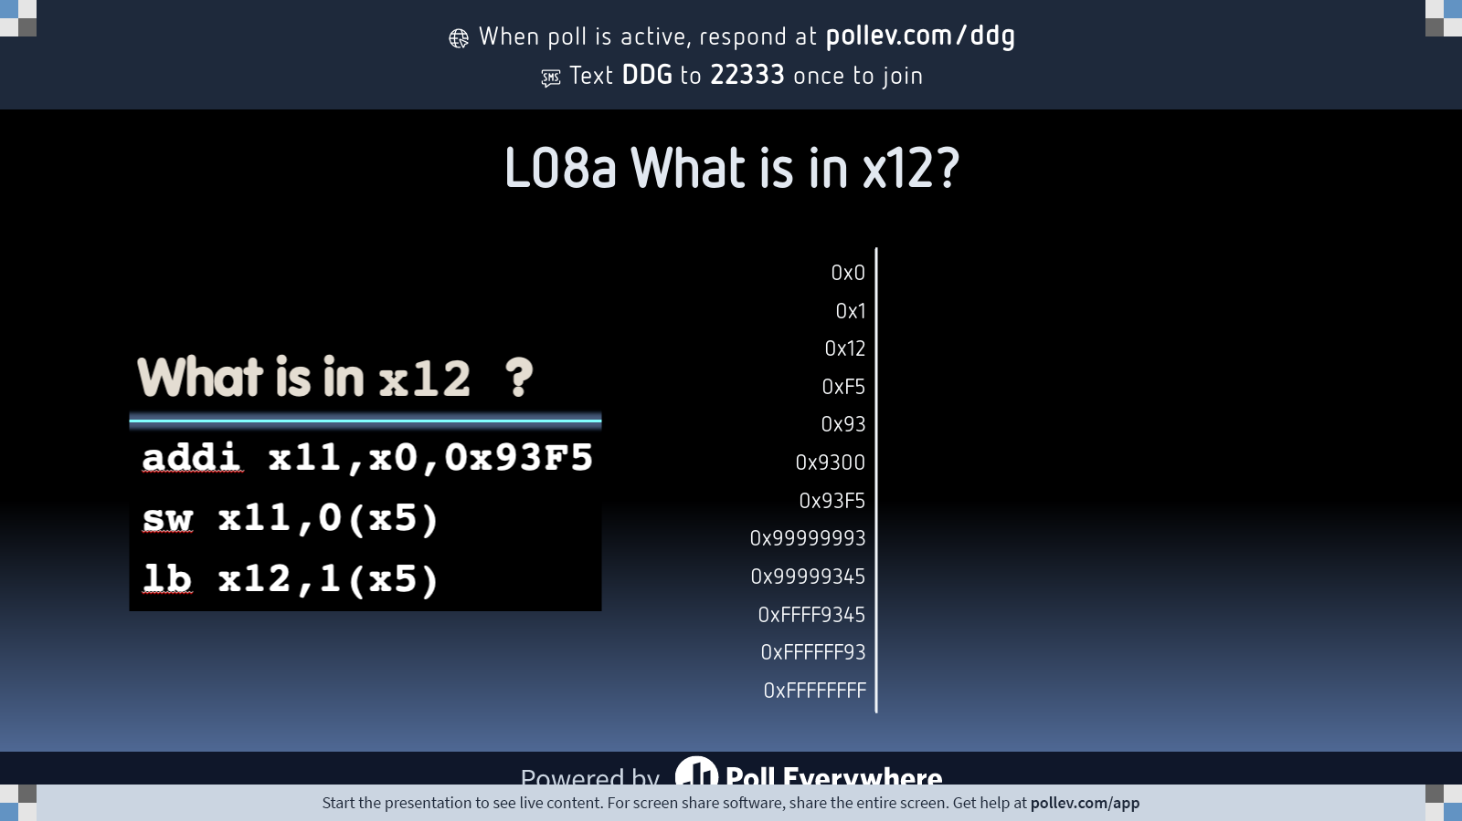
Notes:
Do not modify the notes in this section to avoid tampering with the Poll Everywhere activity. More info at polleverywhere.com/support L08a What is in x12?
https://www.polleverywhere.com/multiple_choice_polls/Osojcr7r3FBD8SNMGTTHc?state=opened&flow=Default&onscreen=persist

Slide 19
Example: Translate *x = *y
We want to translate *x = *y into RISC-V
x, y ptrs stored in: x3 x5
1: add x3, x5, zero
2: add x5, x3, zero
3: lw x3, 0(x5)
4: lw x5, 0(x3)
5: lw x8, 0(x5)
6: sw x8, 0(x3)
7: lw x5, 0(x8)
8: sw x3, 0(x8)
1
2
3
4
5→6
6→5
7→8
Notes:
X11 = 03 f5
X5 = address

Slide 20
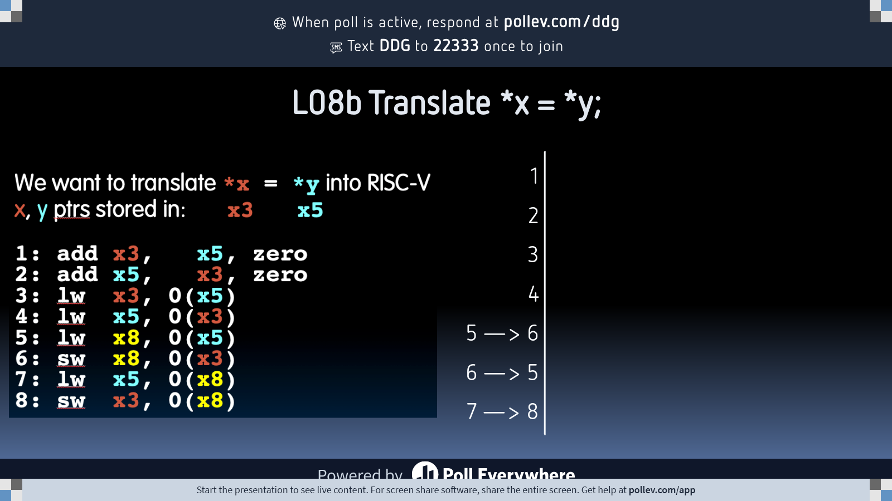
Notes:
Do not modify the notes in this section to avoid tampering with the Poll Everywhere activity. More info at polleverywhere.com/support L08b Translate *x = *y;
https://www.polleverywhere.com/multiple_choice_polls/FrOXvrvUCq453BpOGasn1?state=opened&flow=Default&onscreen=persist

Slide 21
And in Conclusion…
Memory is byte-addressable, but lw and sw access one word at a time.
A pointer (used by lw and sw) is just a memory address, we can add to it or subtract from it (using offset).
Big- vs Little Endian
Tip: draw lowest byte on the right
New Instructions:
lw, sw, lb, sb, lbu

Slide 22
Substituting addi
The following two instructions:
lw x10,12(x15) # Temp reg x10 gets A[3]
add x12,x12,x10 # reg x12 = reg x12 + A[3]
Replace addi:
addi x12, value # value in A[3]
But involve a load from memory!
Add immediate is so common that it deserves its own instruction!

